Slide 1
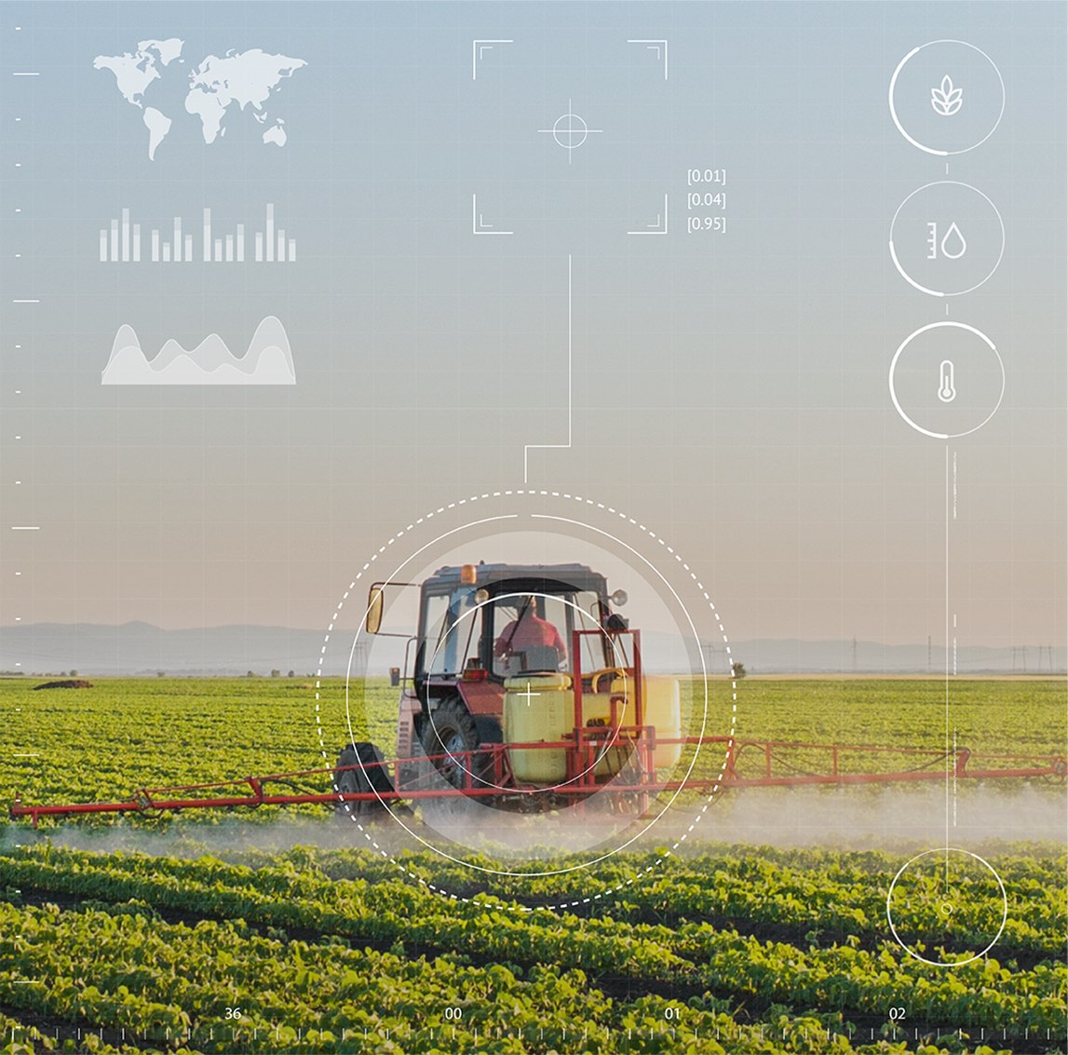
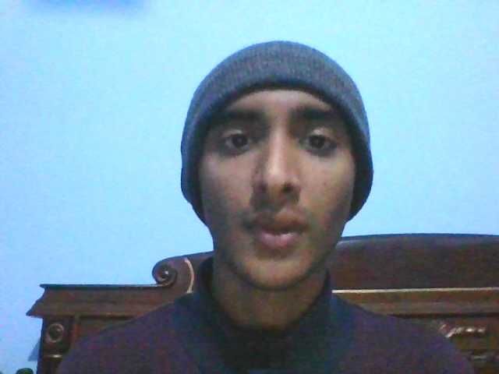
Azure Farmbeats: Plant Monitoring
Notes:
Hello Future Ready Talent, my name is Anurag Sharma and this is my project Azure Farm Beats plant monitoring.

Slide 2

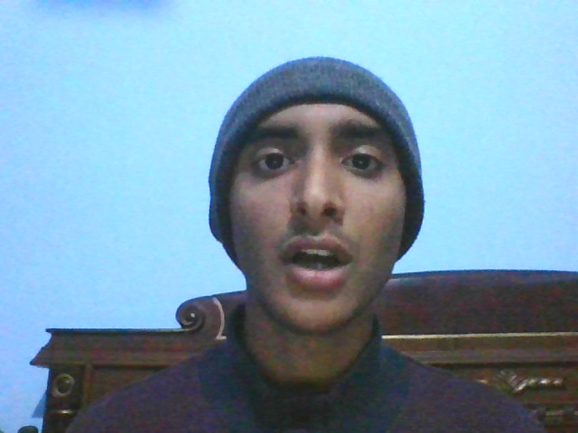
Agenda
Internet of Things (IoT)
Problem Statement
About Farmbeats Project
Phases
Skills Acquired
Applications
Notes:
So in this Short presentation we will discuss:-

Slide 3
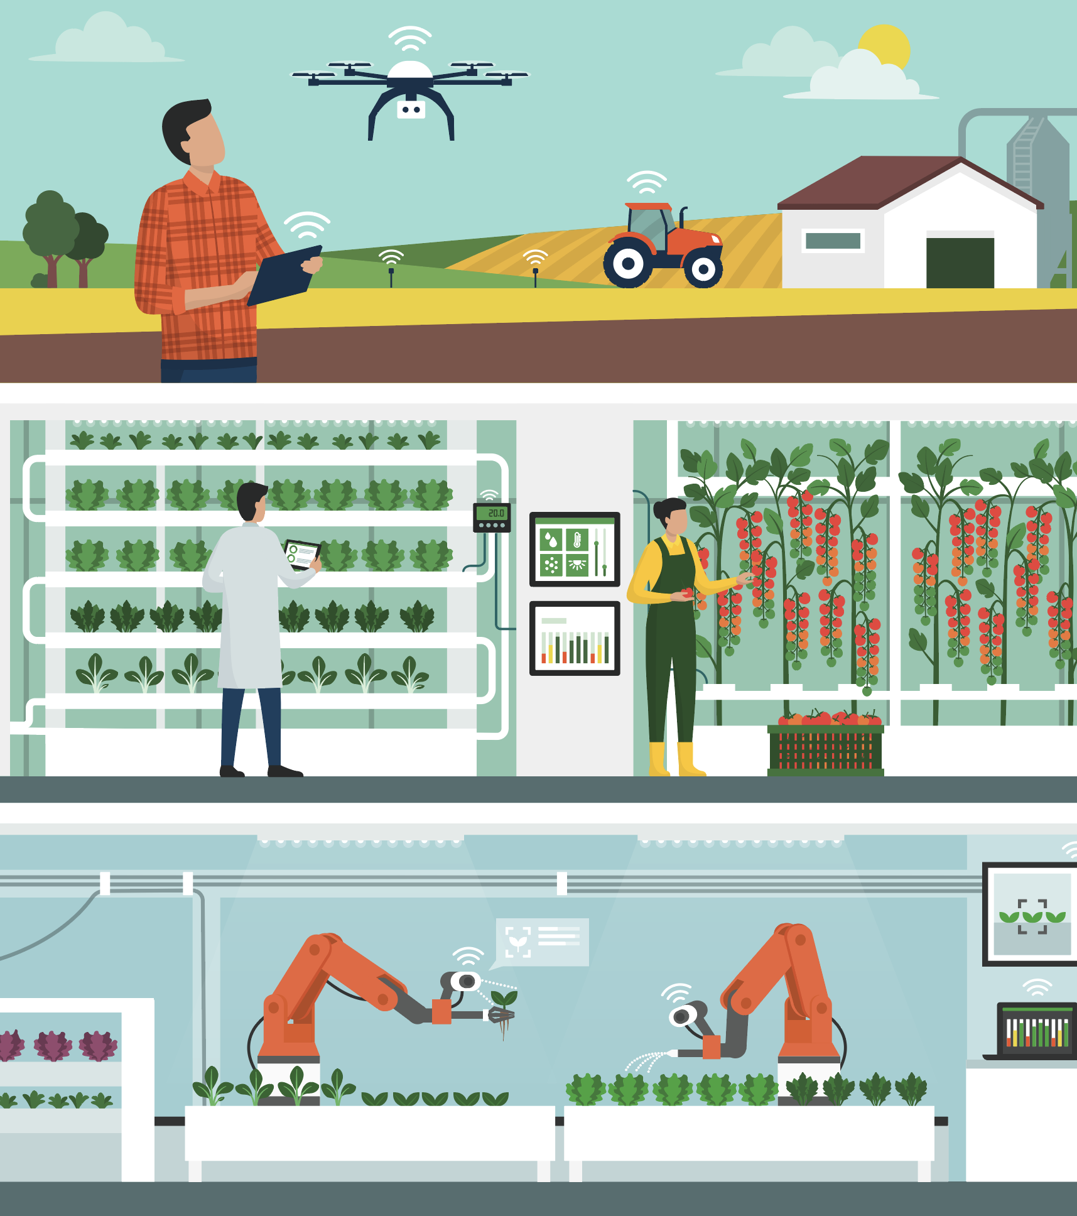

Internet of Things (IoT)
Network of physical objects - "things"
Connect with other objects to exchange information over the Internet
Cars, buildings, manufacturing plants, greenhouses, farms Agriculture Benefits:
Precision Farming
Monitoring the health of livestock
Automation in Smart Greenhouses
Notes:
The Internet of Things (IoT) describes a network of objects – physical things – that connect and exchange information over the Internet with other things through sensors, software, and other types of technology.
Smart home (ex. Thermostats, home security systems)
Raspberry Pi and its sensors in case of my project

Slide 4
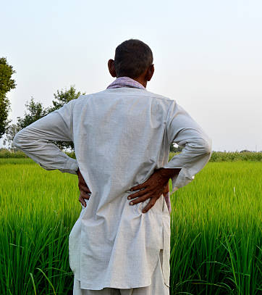
Problem Statement
No Real Time Crop Monitoring
Wasted Resources
Notes:
The problem statement of my project lies is mainly no real time crop monitoring of the plants. If we could just know when the plants need water, sunlight, moisture, our farmers would not only have to waste lot of resources but also would be having a high crop yield based on the data

Slide 5
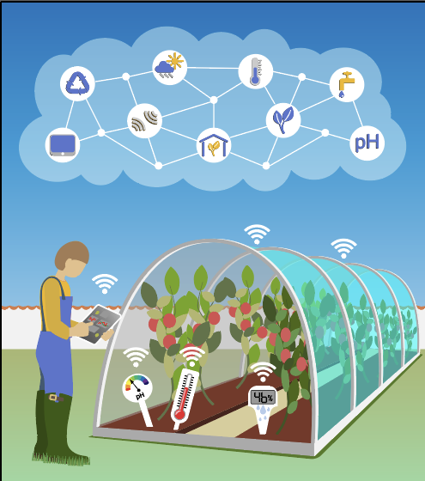
About Farmbeats Project
Computation using Raspberry Pi
Fetching data using different Sensors
Cloud Based Monitoring Dashboard
Getting Real time monitoring
Notes:
So my Farmbeats project works in 4 phases:-

Slide 6
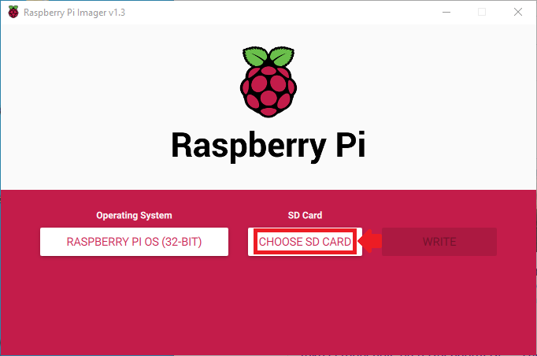
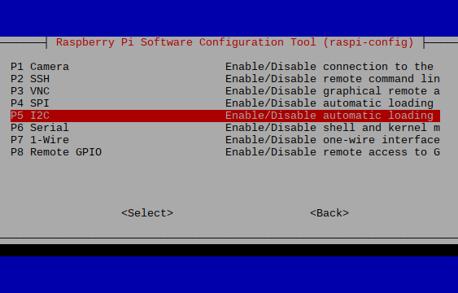
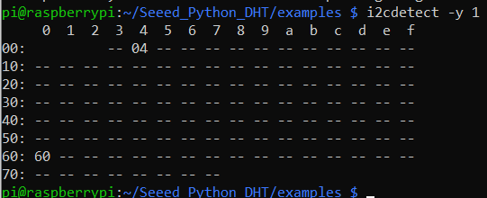
Phase 1: Configuring Raspberry Pi
Downloading Raspberry Pi Imager
Installing Raspberry Pi OS in SD card (with WIFI configured)
Turning On I2C interface
Notes:
Phase-1 includes Downloading the Raspberry Pi OS into the Micro SD Card using Raspberry PI Imager, along with checking the response of connected sensors using I2C interface as you can see in the screenshots

Slide 7
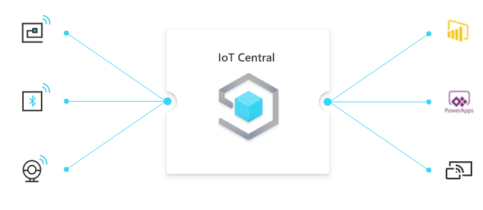
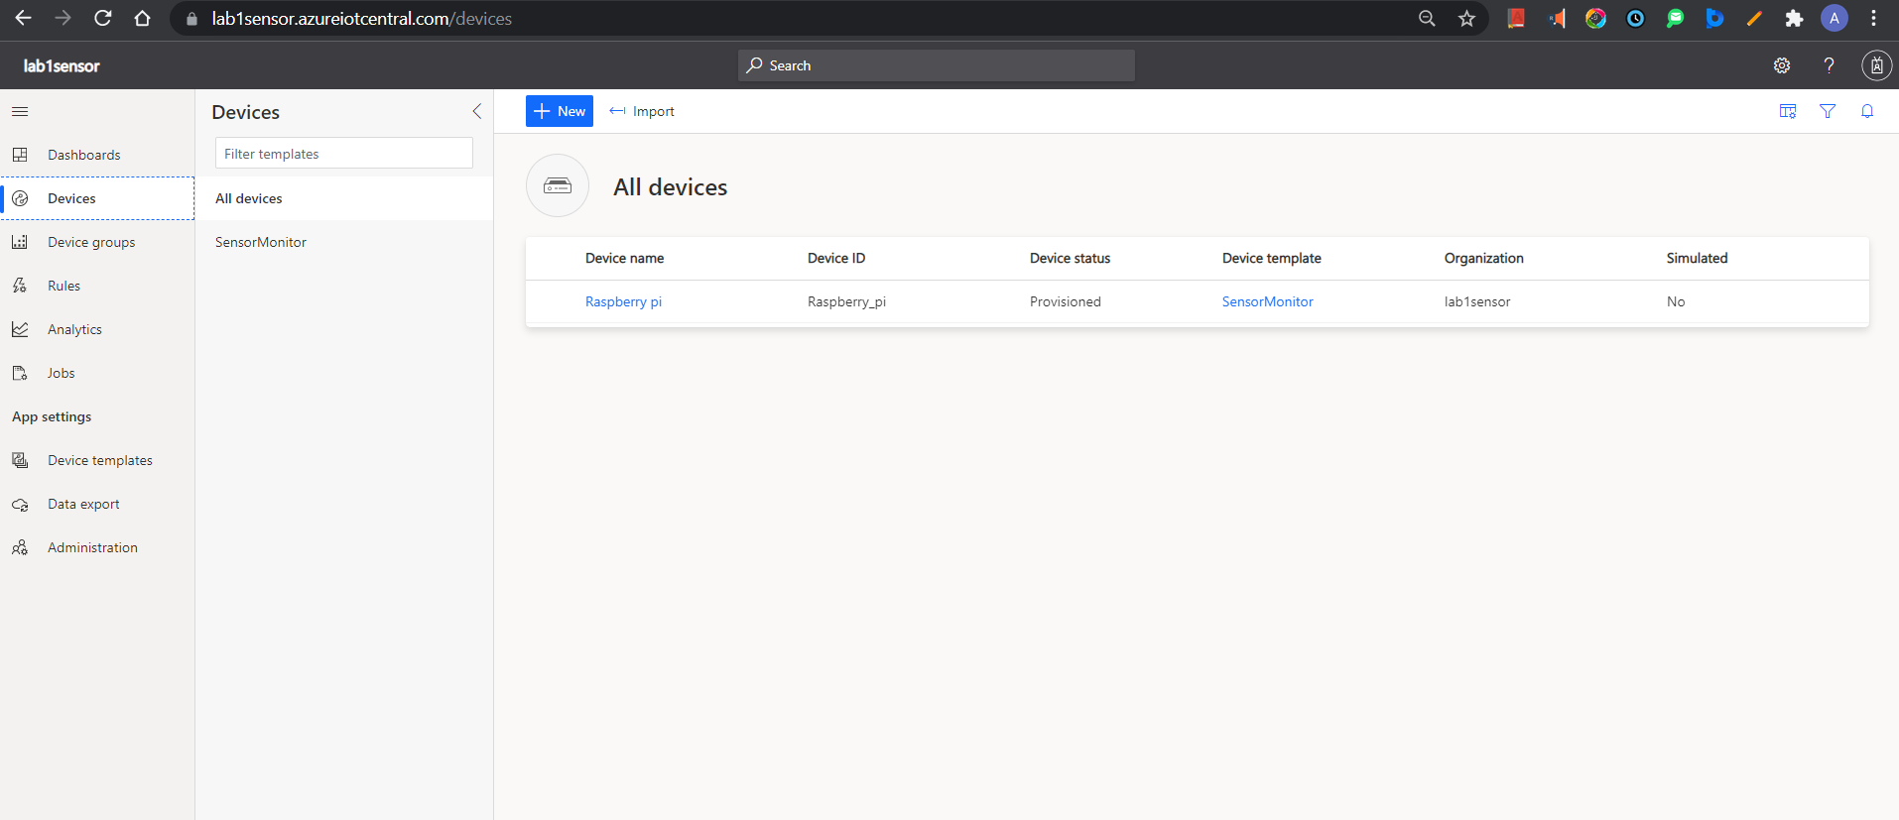
Phase 2: Azure Services Integration
Creating App using Azure IoT Central
Creating IoT Central Application from Azure portal
Creating Device Template inside Azure IoT Central
Notes:
Phase 2 includes creation of IoT Central app using Azure portal and then defining Device templates as per our requirements within the IoT Central Portal

Slide 8
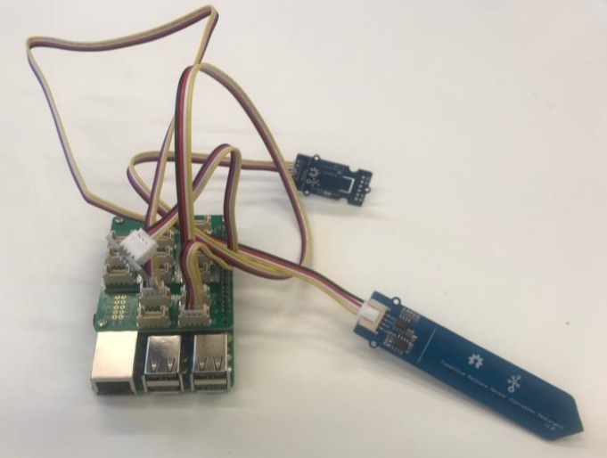
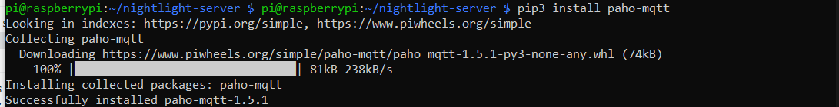
Phase 3: Running the Python Script
Connecting Sensors
Configuring the python virtual environment to python 3
Installing the required libraries
Notes:
Next in Phase-3 we have to create Python 3 virtual environment and then we need to install some sensor specific libraries so that our code can execute successfully

Slide 9
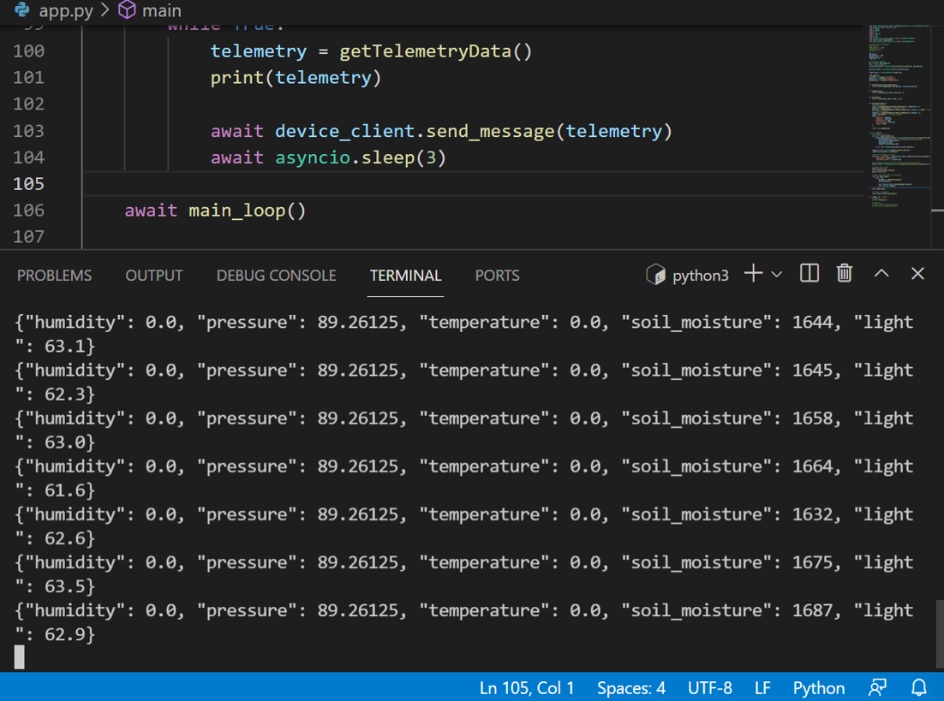
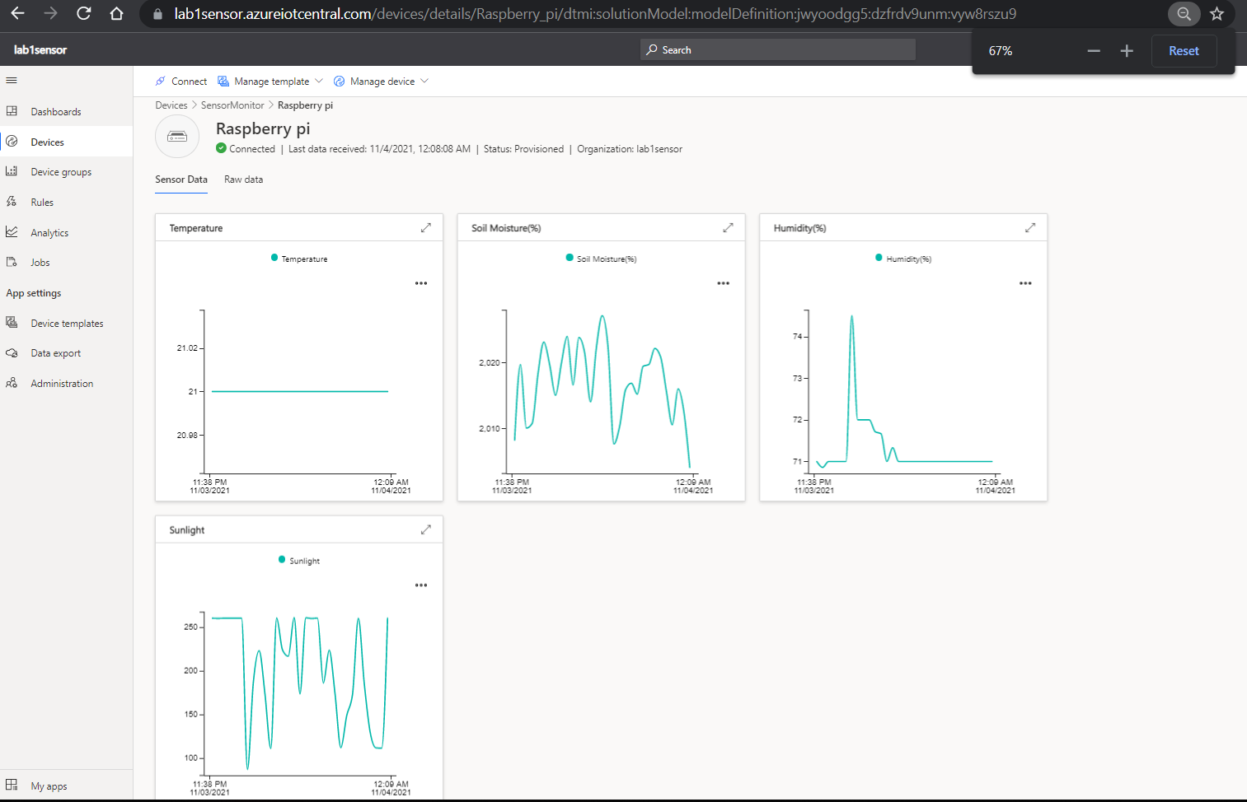
Phase 4: Monitoring
Monitoring the plant using Azure IoT Central Dashboard
Running the Python Code
Notes:
So Finally in Phase-4 as we compile the code, connection is setup between our pi and our IoT central app and we starts seeing the outputs as shown in this slide

Slide 10
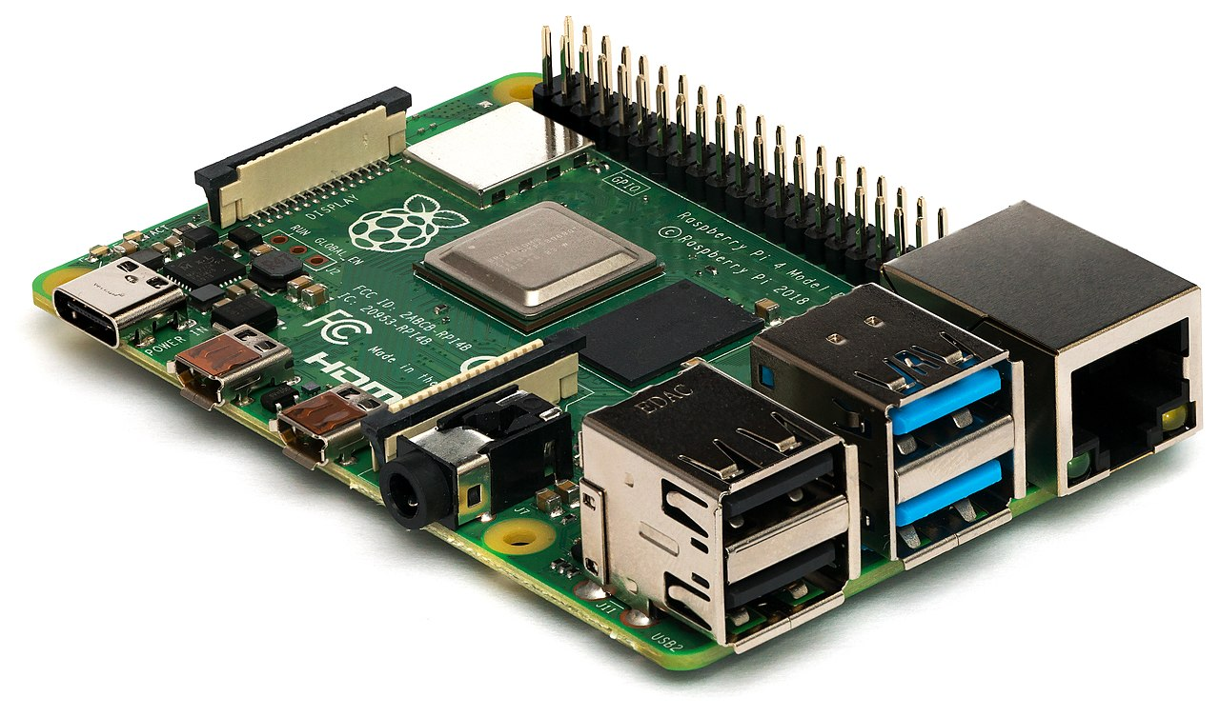
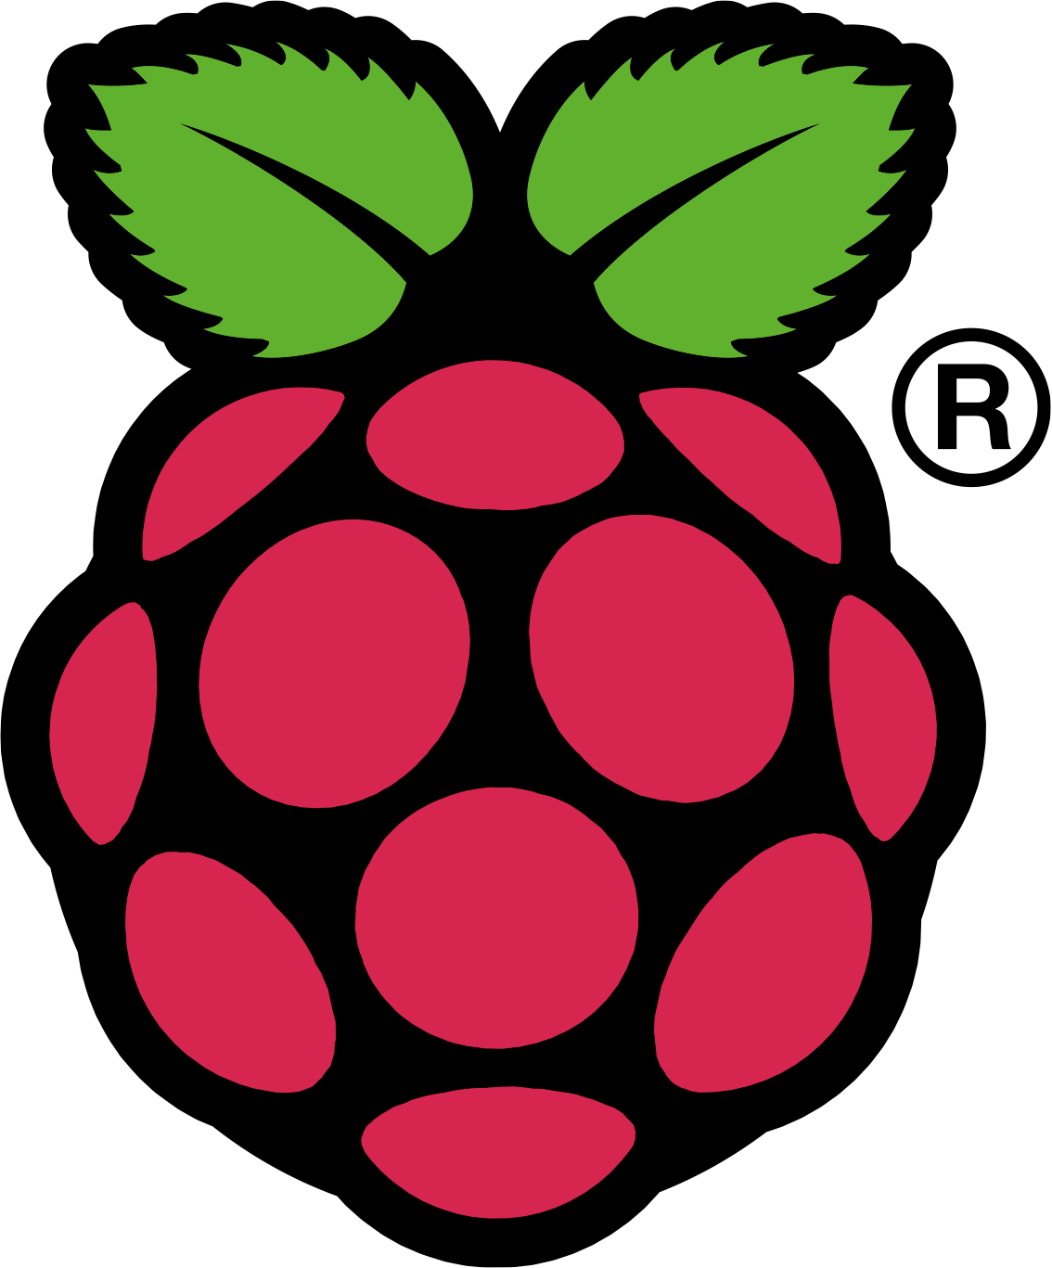
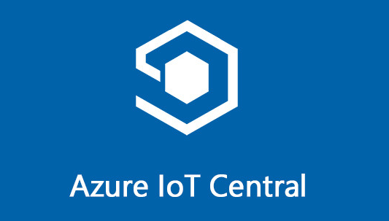

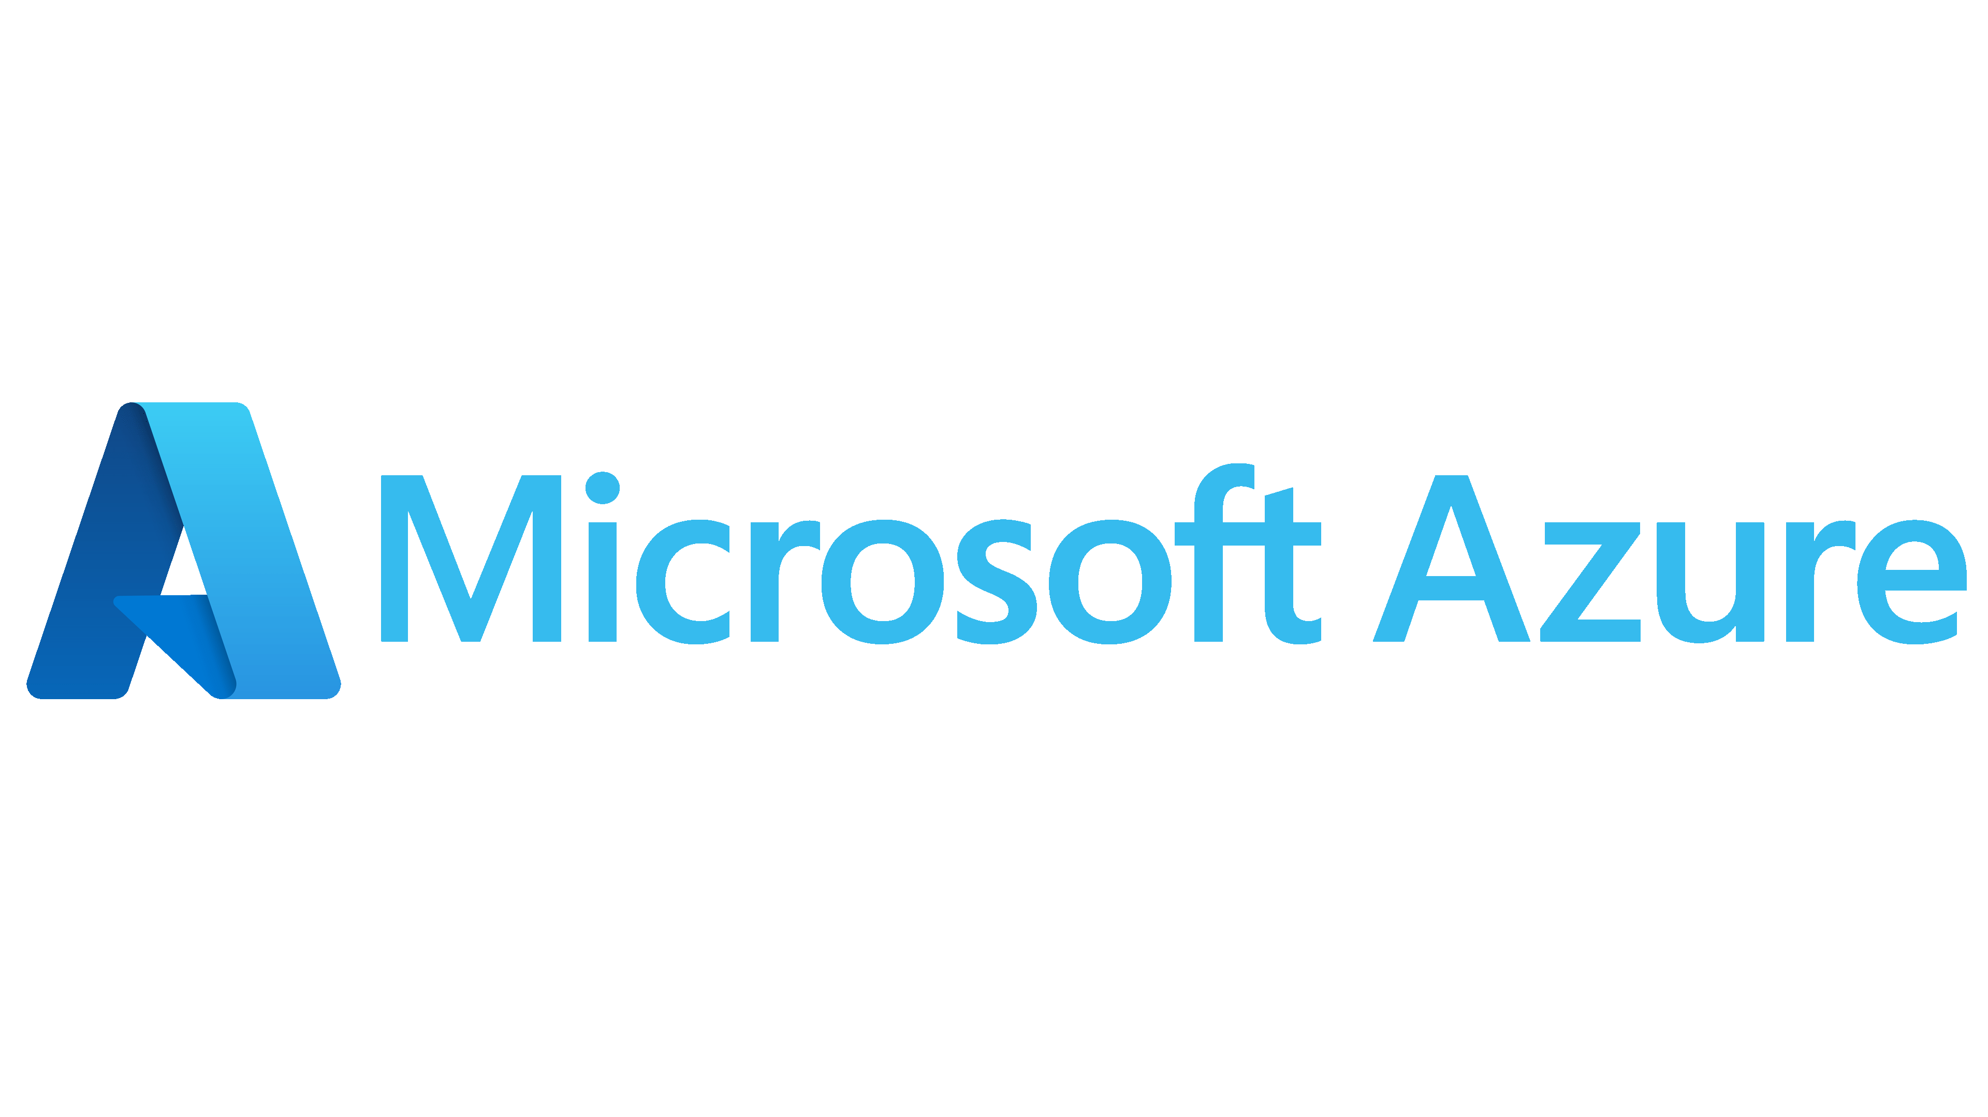
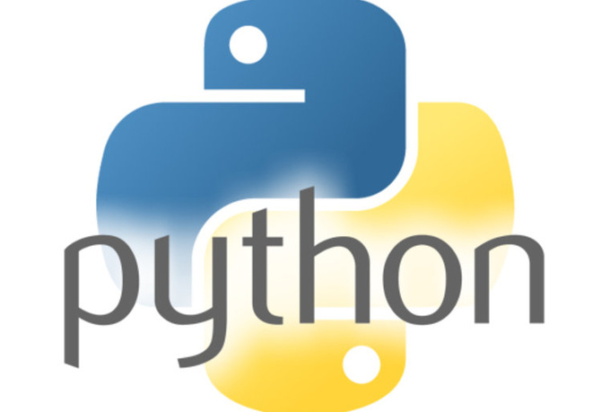
Skills Acquired
This Photo by Unknown Author is licensed under CC BY-SA-NC
This Photo by Unknown Author is licensed under CC BY-SA
Notes:
Here are the 5 skills which I have acquired by doing this project starting from hardware to OS and finally to cloud. i.e ……………..

Slide 11
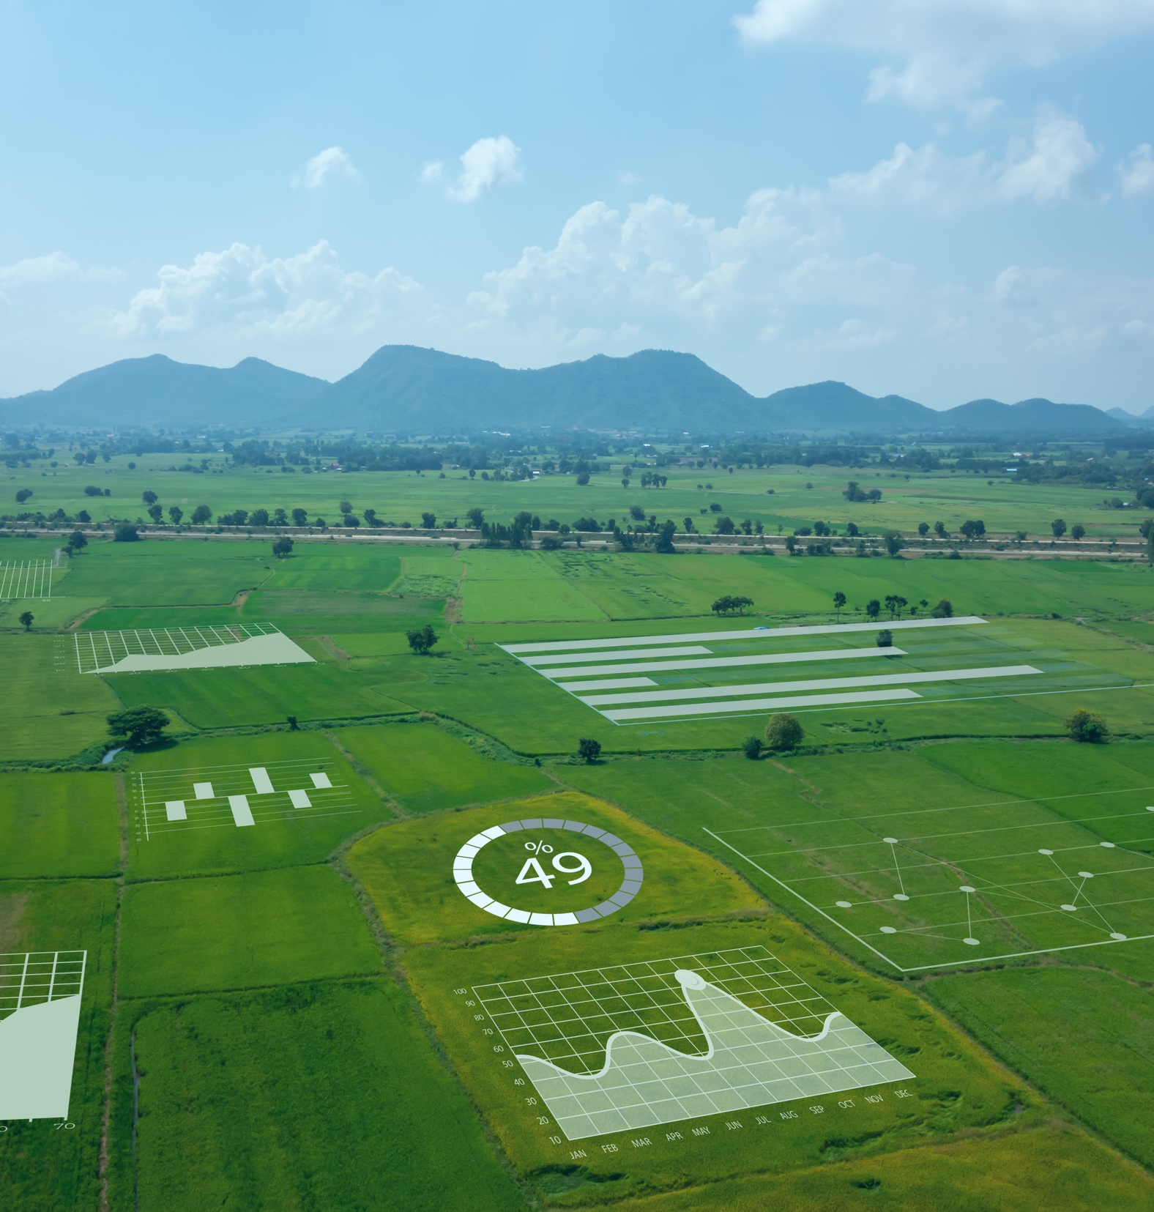
Applications
FASTER: Local data processing and graphing
CHEAPER: Lower operating costs
SAFER: Reduces data security exposure
Smart Farm and Smart Greenhouse:
Environmental Monitoring
Data Analytics
Automation
Notes:
The application of my project is in Smart Farm and Smart Greenhouse providing faster data processing, lower operating costs including data security. The data acquired can further be used for data analytics and automation

Slide 12
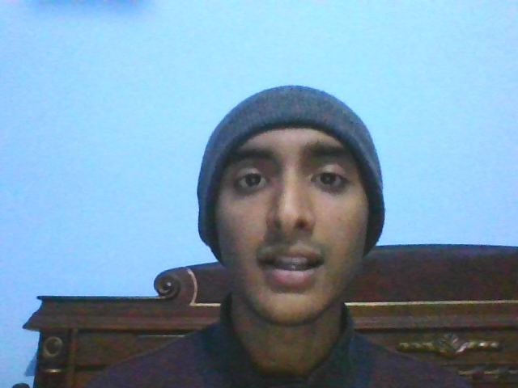
Thank You ☺
Notes:
Thank you and now lets head over to the demo

